Slide 1


Reinforcement Learning
张江
北京师范大学系统科学学院教授
集智俱乐部、集智学园创始人
集智研究中心理事长
更多“人工智能 & 复杂系统”的知识，请关注官网：campus.swarma.org
Notes:
封面

Slide 2
Outline
Basic Notions
AlphaGo
Deep Q-Learning
Reinforcement Learning and Causality
World Models
更多“人工智能 & 复杂系统”的知识，请关注官网：campus.swarma.org

Slide 3
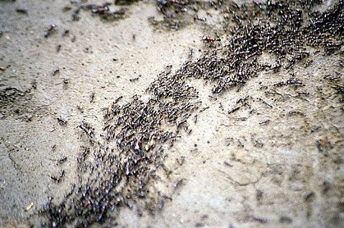
Why RL?
Complex System
Behavior (observations)
AI systems
Models
Prediction, Simulation, Optimization, Controls
更多“人工智能 & 复杂系统”的知识，请关注官网：campus.swarma.org

Slide 4
A Complete Agent
智能体（Intelligent agent）应该是一个完整的可以感知、决策、行动、学习的整体，而不是分开的一系列任务
更多“人工智能 & 复杂系统”的知识，请关注官网：campus.swarma.org

Slide 5
Some Cases
更多“人工智能 & 复杂系统”的知识，请关注官网：campus.swarma.org

Slide 6
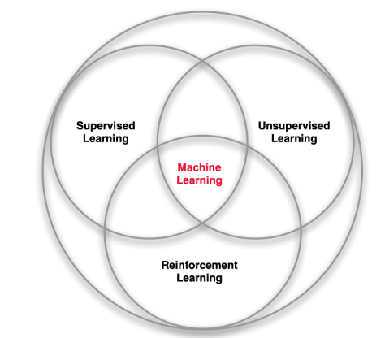
Territory
更多“人工智能 & 复杂系统”的知识，请关注官网：campus.swarma.org

Slide 7
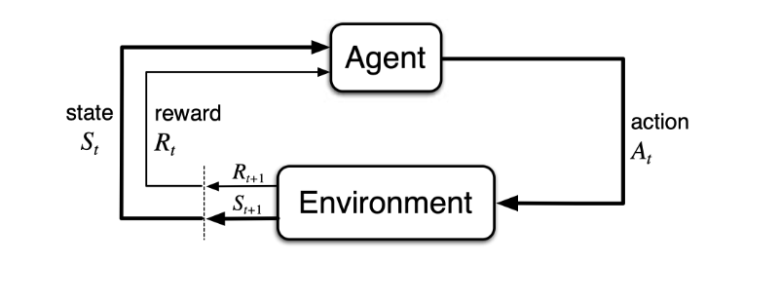
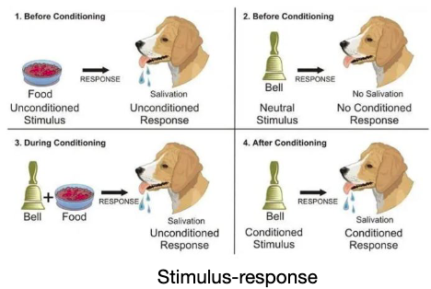
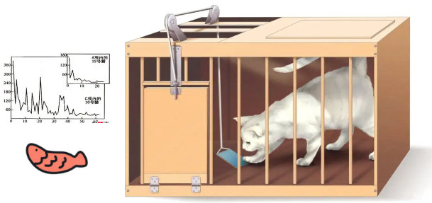
Early histories of RL
Trial-and-Error learning in Psychology
Optimal control and its solution with dynamic programming
Temporal difference learning
更多“人工智能 & 复杂系统”的知识，请关注官网：campus.swarma.org

Slide 8
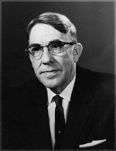
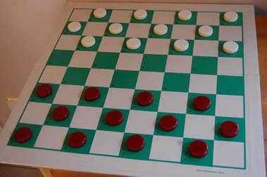
Early history of RL
Reinforcement learning (RL) is an area of machine learning inspired by behaviourist psychology, concerned with how software agents ought to take actions in an environment so as to maximize some notion of cumulative reward.
Arthur Samuel
更多“人工智能 & 复杂系统”的知识，请关注官网：campus.swarma.org

Slide 9
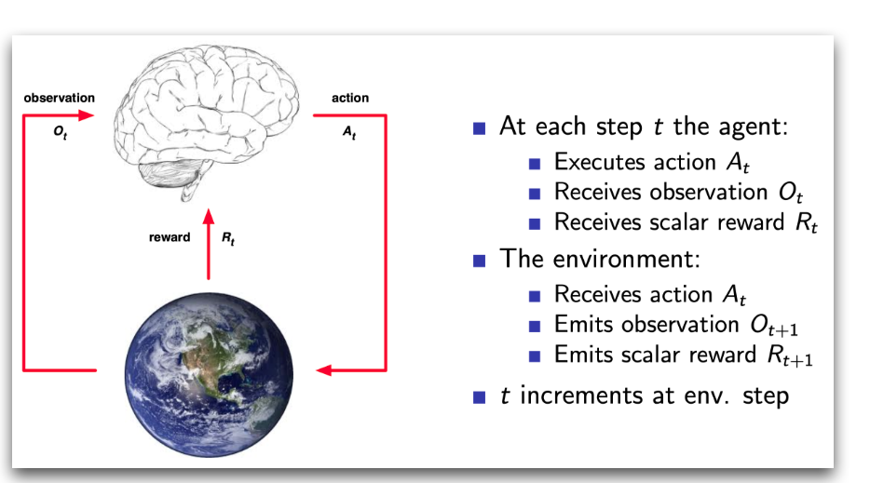
What is RL? – Problem Setting
更多“人工智能 & 复杂系统”的知识，请关注官网：campus.swarma.org

Slide 10
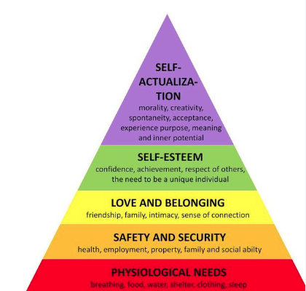
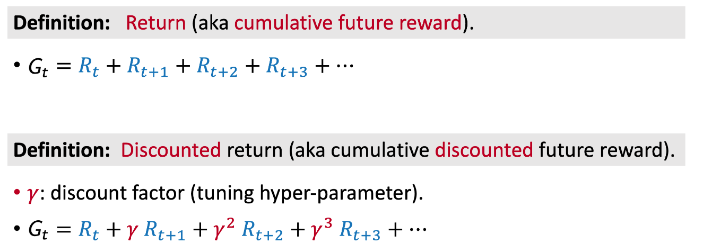
What is RL? – Problem Setting
A reward R_{t} is a scalar feedback signal
The agent’s job is to maximize cumulative reward
Reward Hypothesis
All goals can be described by the maximization of expected cumulative reward
更多“人工智能 & 复杂系统”的知识，请关注官网：campus.swarma.org

Slide 11
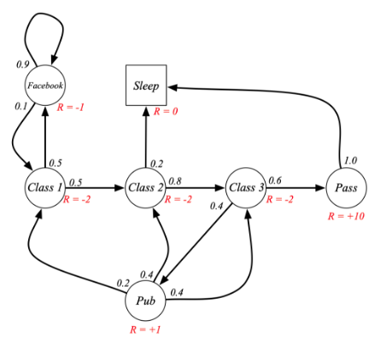
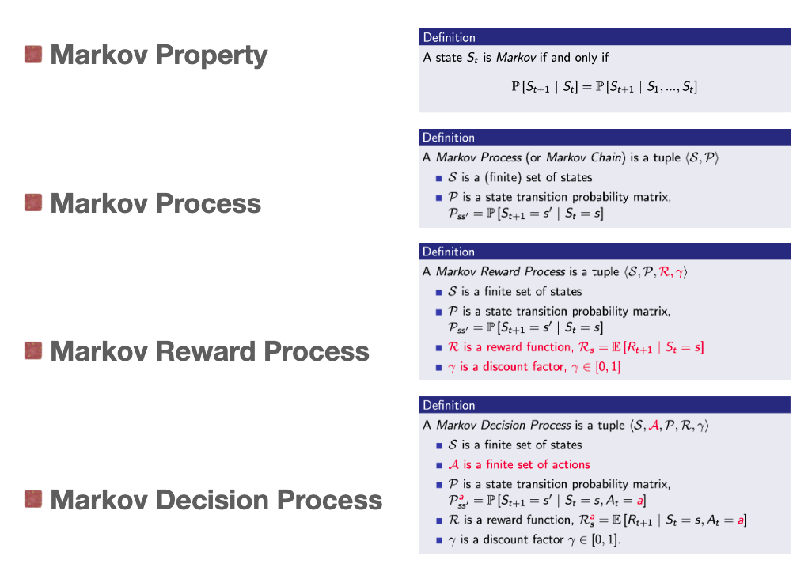
Simplify – Markov Decision Process

Slide 12
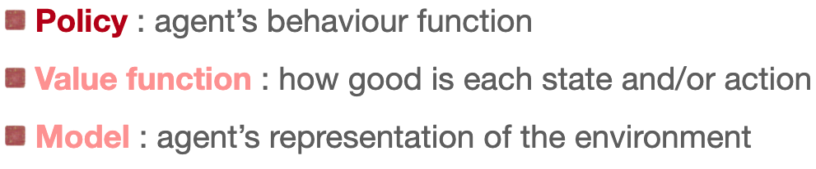
Major Components of an RL Agent
An RL agent may contain one or more these components:
更多“人工智能 & 复杂系统”的知识，请关注官网：campus.swarma.org

Slide 13
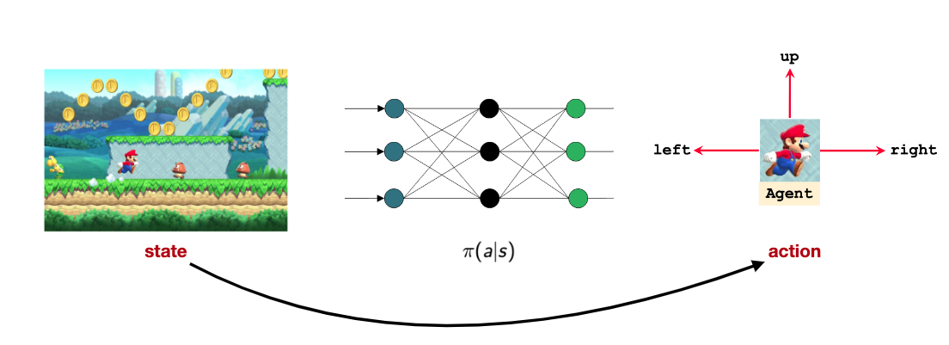
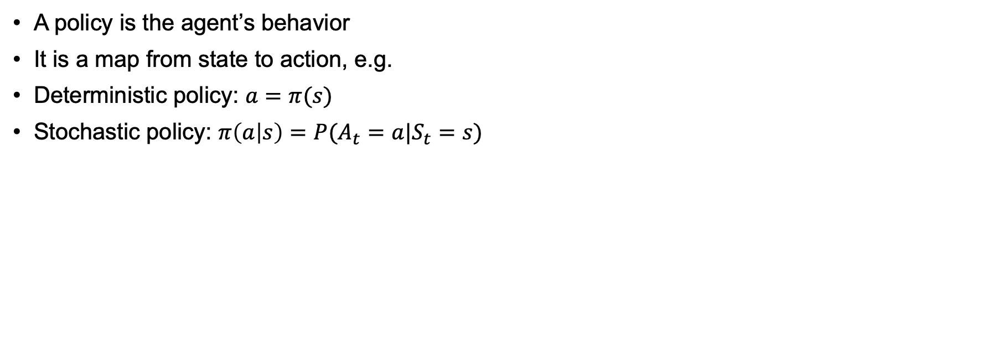
Policy
A policy is the agent’s behavior
It is a map from state to action, e.g.
Deterministic policy: $a=π(s)$
Stochastic policy: $π\left(a | s\right)=P(A_{t}=a|S_{t}=s)$
更多“人工智能 & 复杂系统”的知识，请关注官网：campus.swarma.org

Slide 14
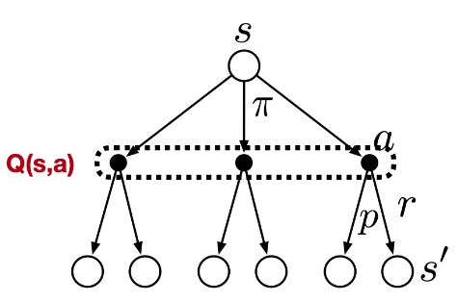
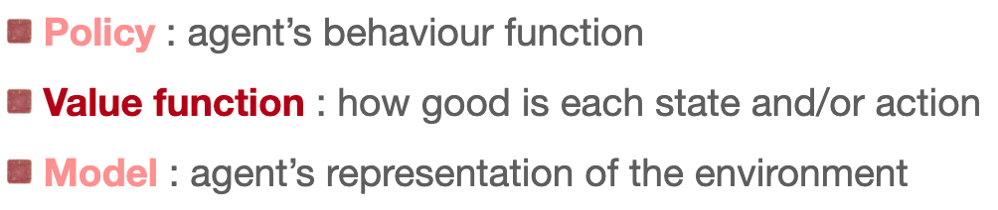
Major Components of an RL Agent
An RL agent may contain one or more these components:
更多“人工智能 & 复杂系统”的知识，请关注官网：campus.swarma.org

Slide 15
Value functions
State-value function: the state-value function $v_{π}(s)$ of an MDP is the expected return starting from state s, and the following policy $π$:
$v_{π}\left(s\right)=𝔼_{π}[G_{t}|S_{t}=s]$
Action-value function: the action-value function $q_{π}(s,a)$ is the expected return starting from state s, taking action a, and then following policy $π$:
$q_{π}\left(s,a\right)=𝔼_{π}[G_{t}|S_{t}=s,A_{t}=a]$
更多“人工智能 & 复杂系统”的知识，请关注官网：campus.swarma.org

Slide 16
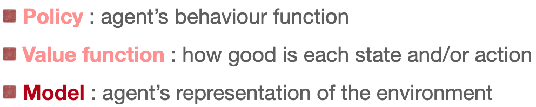
Major Components of an RL Agent
An RL agent may contain one or more these components:
更多“人工智能 & 复杂系统”的知识，请关注官网：campus.swarma.org

Slide 17
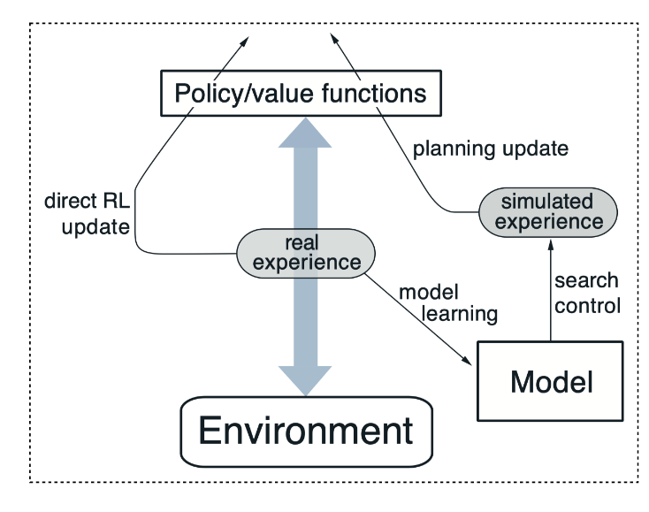
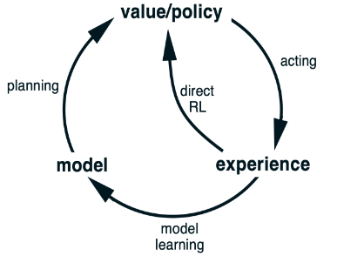
Model
Learn model from experience
Learn behavior in imagination
Act in the environment
Sutton, R.S. (1990). Integrated architectures for learning, planning, and reacting based on approximating dynamic programming. In Machine Learning Proceedings, 216-224, Elsevier, 1990

Slide 18
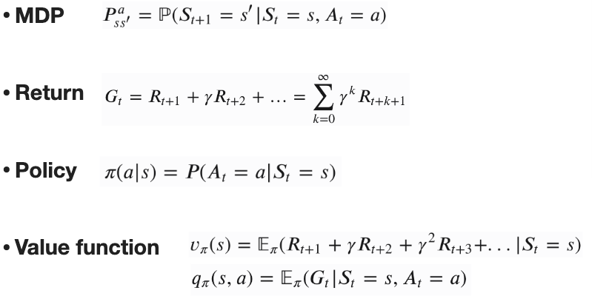
Summary: basic notions
Model
更多“人工智能 & 复杂系统”的知识，请关注官网：campus.swarma.org

Slide 19
Classification
按照Agent对环境的理解程度
Model-free: Q-learning, DQN,…
Model-based: AlphaGo
按照学习对象的划分
Policy based: REINFORCE
Value based: DQN
Policy-value: AlphaGo
Actor-critic: A2C→PPO
更多“人工智能 & 复杂系统”的知识，请关注官网：campus.swarma.org

Slide 20
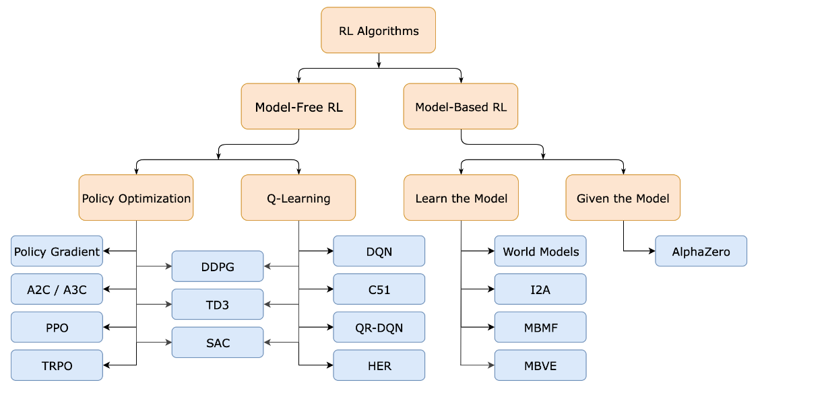
Classification
https://spinningup.openai.com/en/latest/spinningup/rl_intro2.html

Slide 21
Outline
Basic Notions
AlphaGo
Deep Q-Learning
Reinforcement Learning and Causality
World Models
更多“人工智能 & 复杂系统”的知识，请关注官网：campus.swarma.org

Slide 22
Alpha Go
Environment S: configuration
Action of Agent: next move
Transition of Environments: Depend on the opponent player
Feedback: win or lose
Silver, D., Huang, A., Maddison, C. et al. Mastering the game of Go with deep neural networks and tree search. Nature 529, 484–489 (2016).

Slide 23
Architecture of Alpha Go
Searching Phase
Learning Phase
Silver, D., Huang, A., Maddison, C. et al. Mastering the game of Go with deep neural networks and tree search. Nature 529, 484–489 (2016).

Slide 24
Architecture of Alpha Go
SL Policy
RL Policy
Value
Learning Phase
Silver, D., Huang, A., Maddison, C. et al. Mastering the game of Go with deep neural networks and tree search. Nature 529, 484–489 (2016).

Slide 25
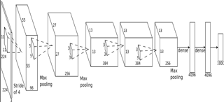
Supervised policy network
Probability of Next Move
13 layers CNN
KBS platform of players
Silver, D., Huang, A., Maddison, C. et al. Mastering the game of Go with deep neural networks and tree search. Nature 529, 484–489 (2016).

Slide 26
Reinforcement Learning Policy Network
Self-play until the end: z=+-1:
Current
Random selected policy network
Policy gradient
Weights
Silver, D., Huang, A., Maddison, C. et al. Mastering the game of Go with deep neural networks and tree search. Nature 529, 484–489 (2016).

Slide 27
Reinforcement Learning Policy Network
Self-play via policy network, until end: z=+-1,
Get average value of z from 30 million games
Weight update
Silver, D., Huang, A., Maddison, C. et al. Mastering the game of Go with deep neural networks and tree search. Nature 529, 484–489 (2016).

Slide 28
Architecture of Alpha Go
Searching Phase
Learning Phase
Silver, D., Huang, A., Maddison, C. et al. Mastering the game of Go with deep neural networks and tree search. Nature 529, 484–489 (2016).

Slide 29
Monte Carlo Tree Search
Number: Win Times/ Total
Multi-times Simulation from one state
Select a move with maximized value
Fast simulation with at un-expanded node (Rollout Policy Network)
Update all weights from bottom up
Silver, D., Huang, A., Maddison, C. et al. Mastering the game of Go with deep neural networks and tree search. Nature 529, 484–489 (2016).

Slide 30
Selection
做选择:
用监督学习训练的走棋网络
次数

Slide 31
Evaluation
For each leaf node:
Value Network
Rollout Policy Network
Silver, D., Huang, A., Maddison, C. et al. Mastering the game of Go with deep neural networks and tree search. Nature 529, 484–489 (2016).

Slide 32
Backup
某一条连边被重复越多，权重越大，越相信它的估值
Silver, D., Huang, A., Maddison, C. et al. Mastering the game of Go with deep neural networks and tree search. Nature 529, 484–489 (2016).

Slide 33
Summary for Mixture
估值网络v
走棋网络ρ
人类经验σ
Q值
V(S)
1-λ
N加权
走棋、选择
快速走棋模拟
人类经验π
λ
人类走棋经验σ
1/N加权
Silver, D., Huang, A., Maddison, C. et al. Mastering the game of Go with deep neural networks and tree search. Nature 529, 484–489 (2016).

Slide 34
Results
Silver, D., Huang, A., Maddison, C. et al. Mastering the game of Go with deep neural networks and tree search. Nature 529, 484–489 (2016).

Slide 35
Outline
Basic Notions
AlphaGo
Deep Q-Learning
Reinforcement Learning and Causality
World Models
更多“人工智能 & 复杂系统”的知识，请关注官网：campus.swarma.org

Slide 36
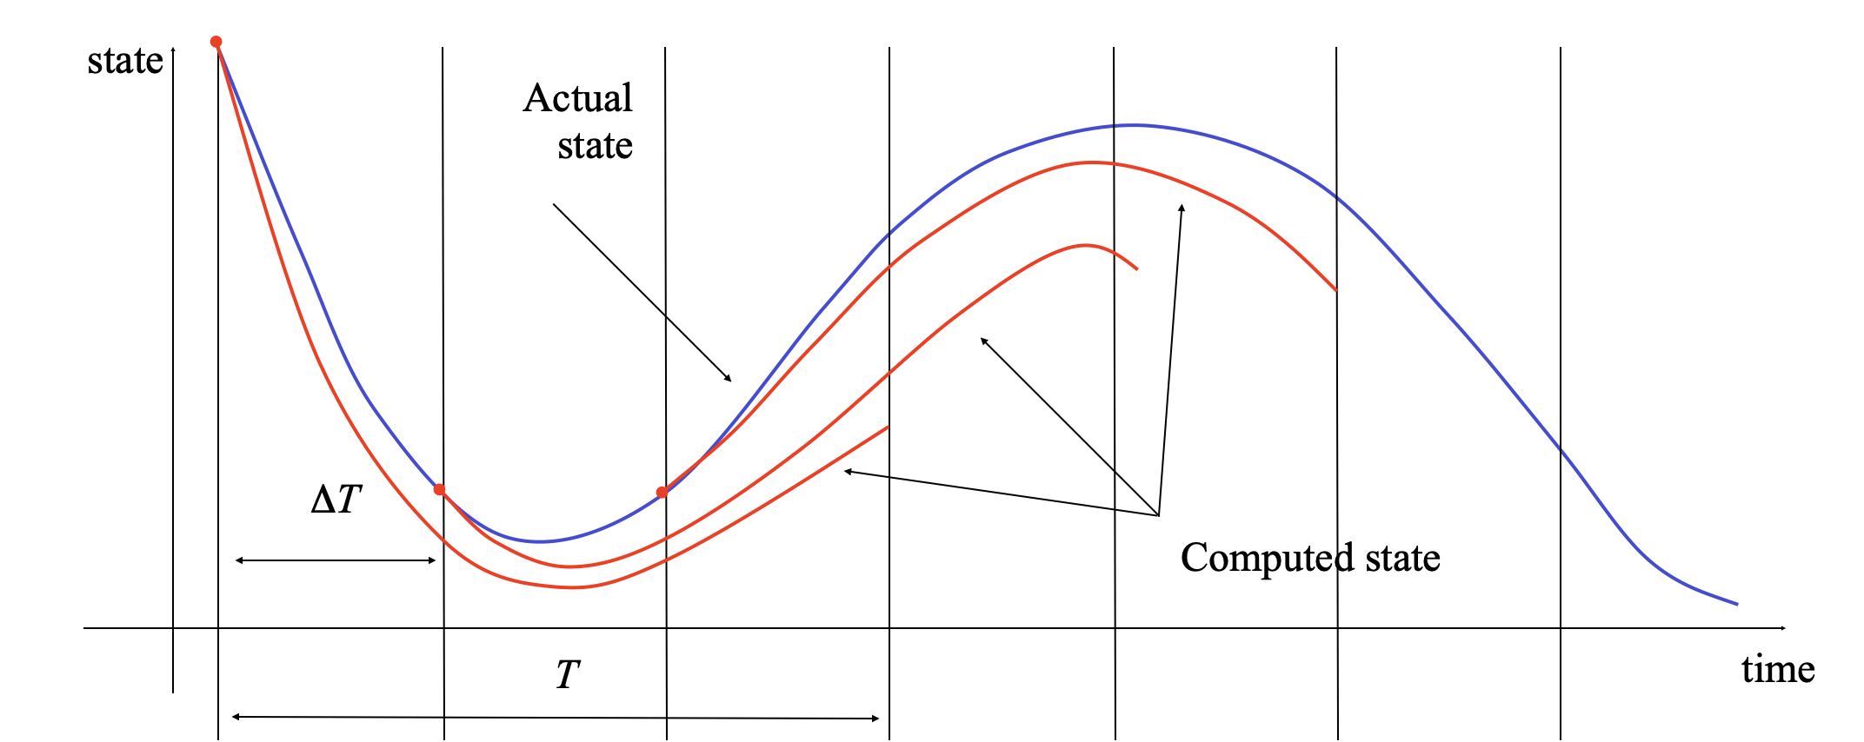
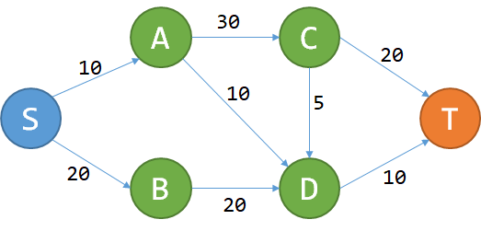
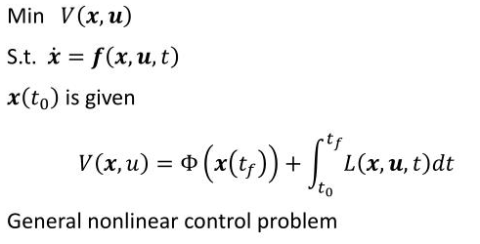
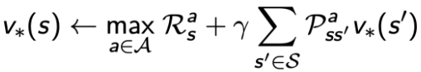
Optimal Control and Dynamic Programming
Optimal Control
Dynamic Programming
https://www.zhihu.com/question/23995189

Slide 37
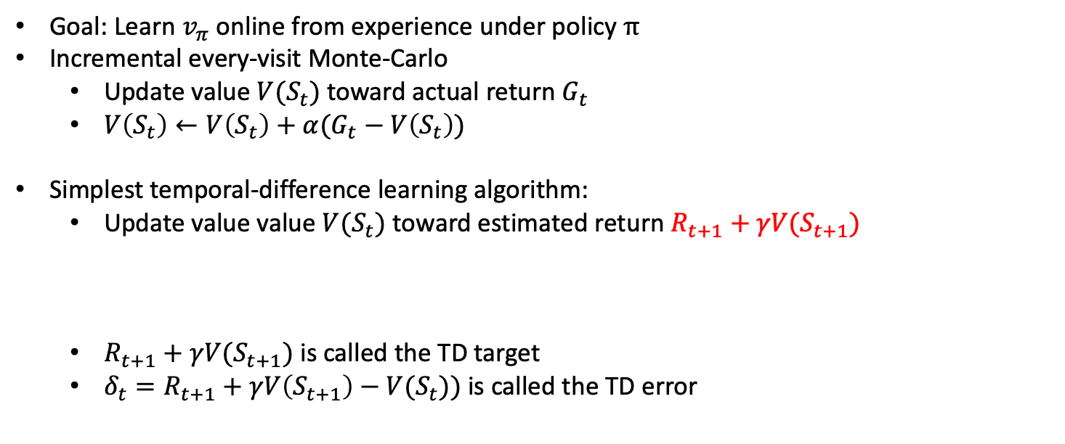
Temporal-difference Learning
Goal: Learn $v_{π}$ online from experience under policy $π$
Incremental every-visit Monte-Carlo
Update value $V(S_{t})$ toward actual return $G_{t}$
$V\left(S_{t}\right)←V\left(S_{t}\right)+α(G_{t}−V\left(S_{t}\right))$
Simplest temporal-difference learning algorithm:
Update value value $V(S_{t})$ toward estimated return $R_{t+1}+γV(S_{t+1})$
$R_{t+1}+γV(S_{t+1})$ is called the TD target
$δ_{t}=R_{t+1}+γV\left(S_{t+1}\right)−V(S_{t}))$ is called the TD error
$$V\left(S_{t}\right)←V\left(S_{t}\right)+α(R_{t+1}+γV\left(S_{t+1}\right)−V(S_{t}))$$
Arthur Samuel

Slide 38
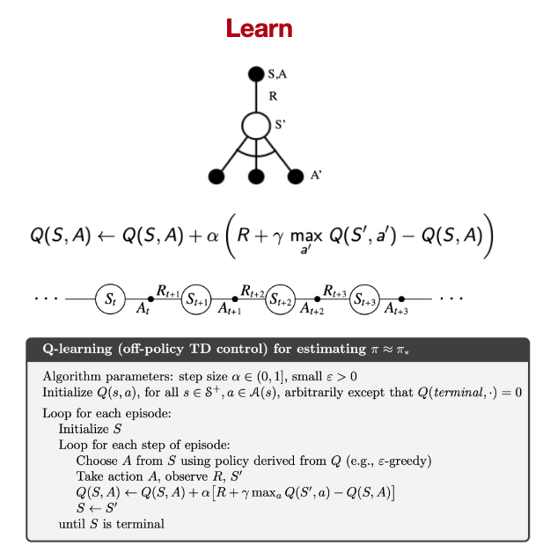
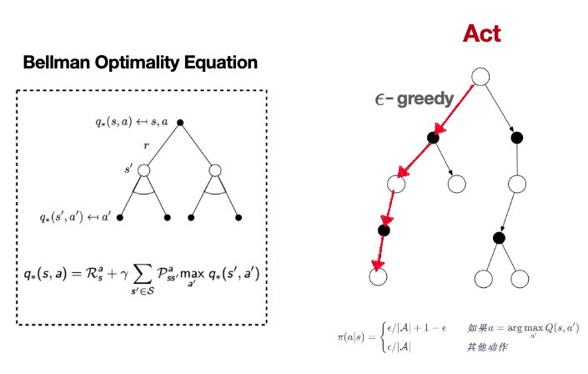
Q-Learning Algorithm

Slide 39
Deep Q Network
Human-level control through deep reinforcement learning https://www.nature.com/articles/nature14236

Slide 40
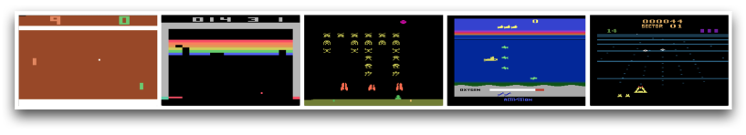
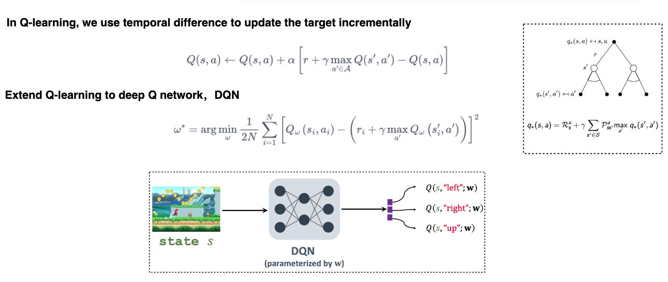
Deep Q Network
Human-level control through deep reinforcement learning https://www.nature.com/articles/nature14236

Slide 41
Deep Q Network
s'
s
a
r
Human-level control through deep reinforcement learning https://www.nature.com/articles/nature14236

Slide 42
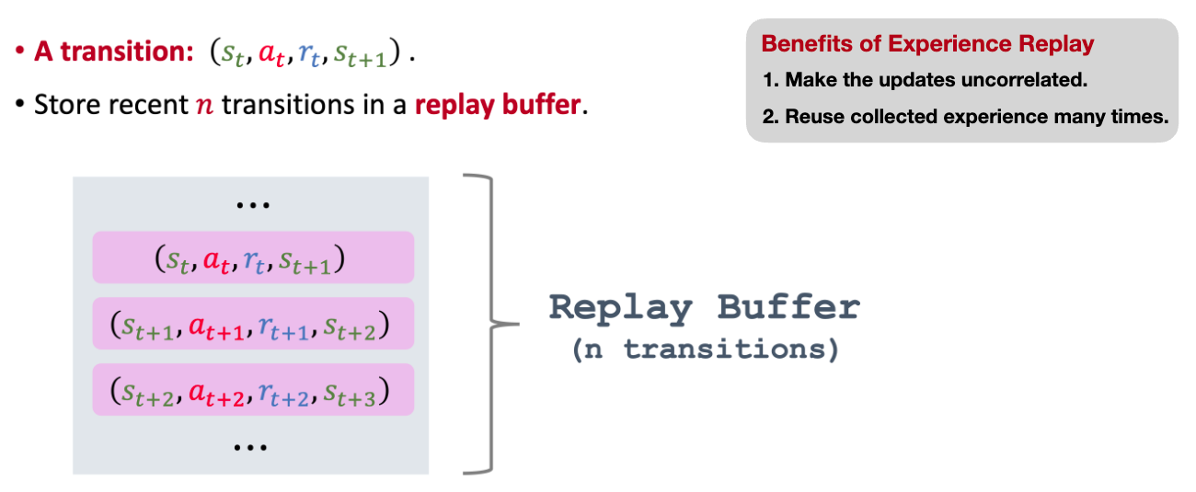
Experience Replay
Human-level control through deep reinforcement learning https://www.nature.com/articles/nature14236

Slide 43
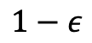
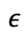
One Step Action
𝜖贪婪
随机行动a(t)
$$ε$$
调用游戏引擎，进行一步游戏，返回s‘,r
将(s,a,r,s’,T)放入训练集D中
从D中随机抽取一个Batch，训练网络
开始
随机产生一个ϵ
根据场景，调用网络，生成行动a(t)
$$1−ε$$
Human-level control through deep reinforcement learning https://www.nature.com/articles/nature14236

Slide 44
One Step Learning
Target=r
从D中随机抽取出一个mini-batch: (S,A,R,S’,T)
循环(S,A,R,S’,T)中的每一个s,a,r,s’,t
T
计算误差L=(Q(s,a)-Target)²
L.backward()
Optimizer.step()
开始
将s’送入神经网络得出maxQ(s’,a’)
Target=r +ϒ maxQ(s’,a’)
Not T
Human-level control through deep reinforcement learning https://www.nature.com/articles/nature14236

Slide 45
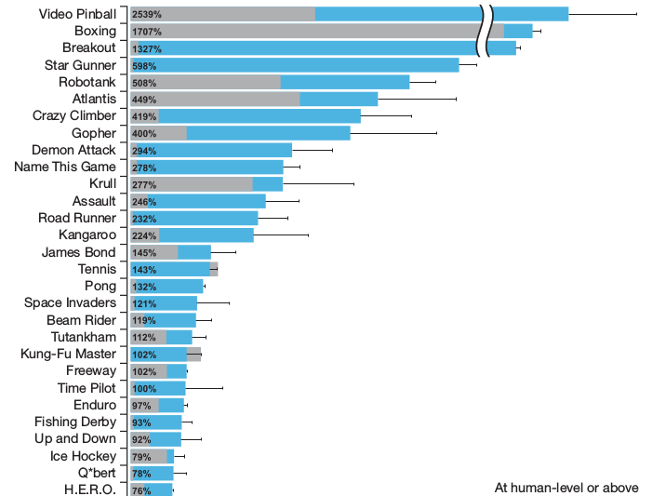
Results
Human-level control through deep reinforcement learning https://www.nature.com/articles/nature14236

Slide 46
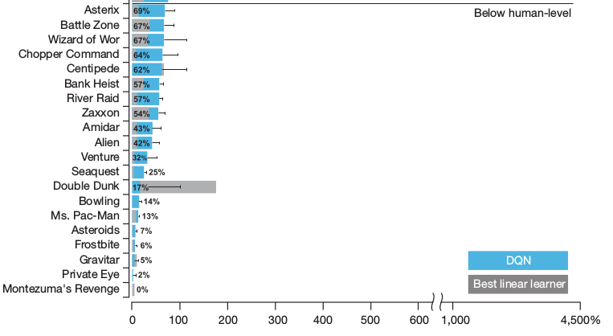
Results
Human-level control through deep reinforcement learning https://www.nature.com/articles/nature14236

Slide 47
Emergent Abilities
Human-level control through deep reinforcement learning https://www.nature.com/articles/nature14236

Slide 48
Visualization
蓝色：人类
橙色：机器
Human-level control through deep reinforcement learning https://www.nature.com/articles/nature14236

Slide 49
DQN - AGI
Artificial general intelligence (AGI) is the intelligence of a machine that could successfully perform any intellectual task that a human being can.
DQN可以看作游戏世界中的AGI
Human-level control through deep reinforcement learning https://www.nature.com/articles/nature14236

Slide 50
Outline
Basic Notions
AlphaGo
Deep Q-Learning
Causal Reinforcement Learning
World Models
更多“人工智能 & 复杂系统”的知识，请关注官网：campus.swarma.org

Slide 51
Causality and Intervention
A
B
C
E
D
更多“人工智能 & 复杂系统”的知识，请关注官网：campus.swarma.org

Slide 52
Causality and Intervention
A
B
C
Interaction, Intervention
E
D
更多“人工智能 & 复杂系统”的知识，请关注官网：campus.swarma.org

Slide 53
Causality and Intervention
A
B
C
E
How to do action
D
更多“人工智能 & 复杂系统”的知识，请关注官网：campus.swarma.org

Slide 54
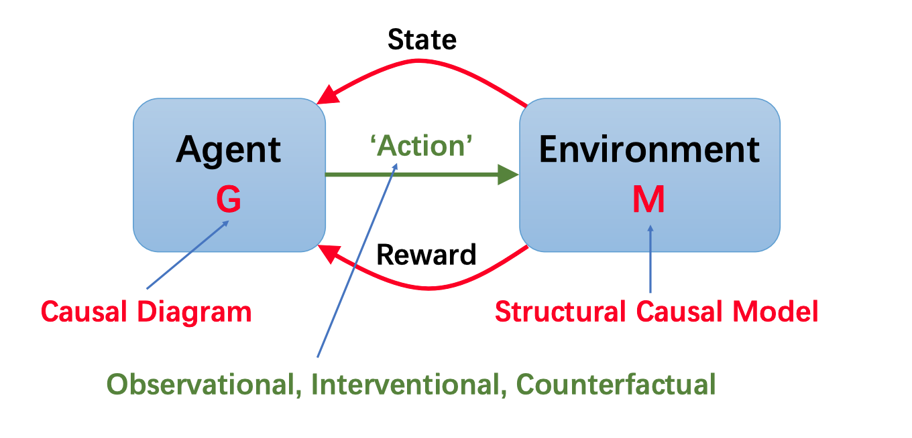
Causal Reinforcement Learning
Chaochao Lu, Nov 2023 in Swarma Club

Slide 55
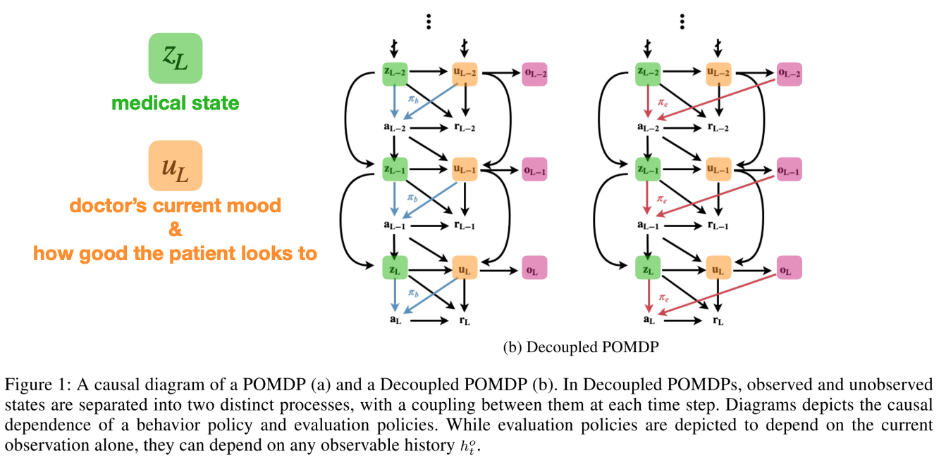
Observational: off-policy evaluation
Tennenholtz et al. Off-Policy Evaluation in Partially Observable Environments. 2019

Slide 56
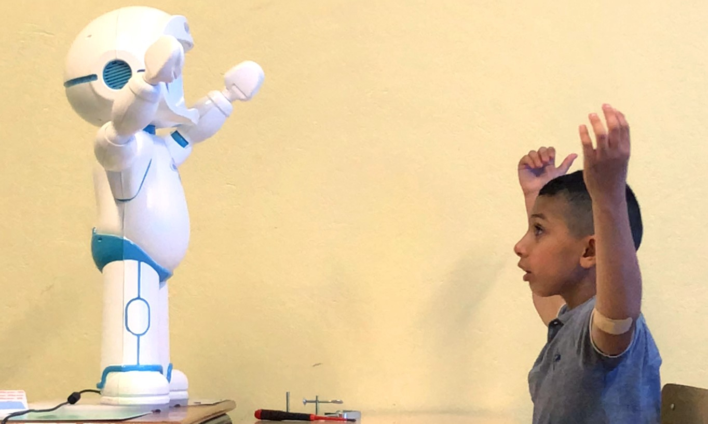
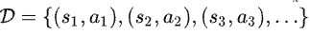
Observational: Imitation Learning
de Hann et al. Causal Confusion in Imitation Learning, 2018

Slide 57
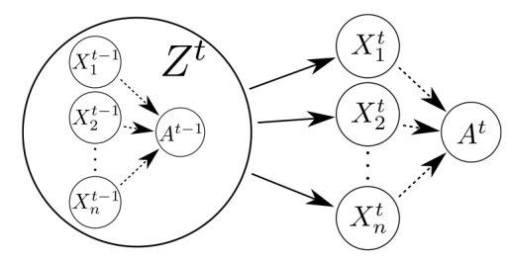
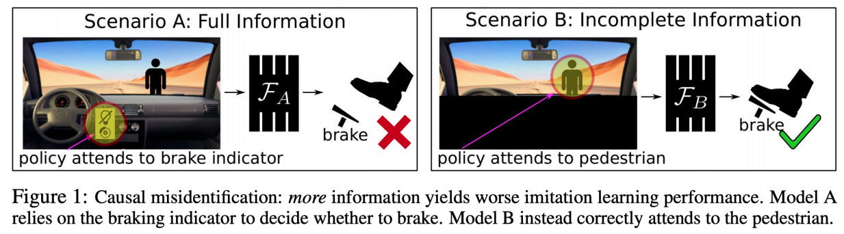
Interventional: self-driving
de Hann et al. Causal Confusion in Imitation Learning, 2018

Slide 58
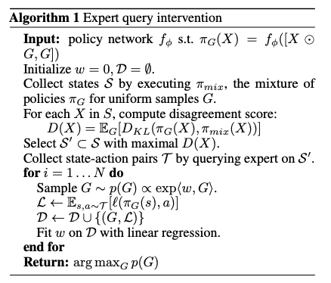
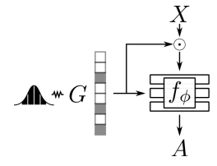
Interventional: self-driving
de Hann et al. Causal Confusion in Imitation Learning, 2018

Slide 59
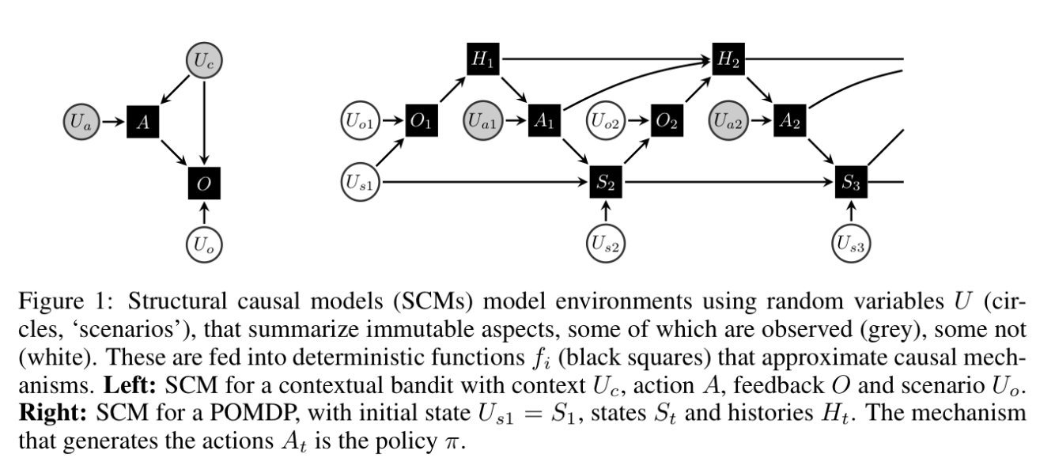
Counterfactual: policy search
Buesing et al. Woulda, Coulda, Shoulda: Counterfactually-Guided Policy Search, 2019

Slide 60
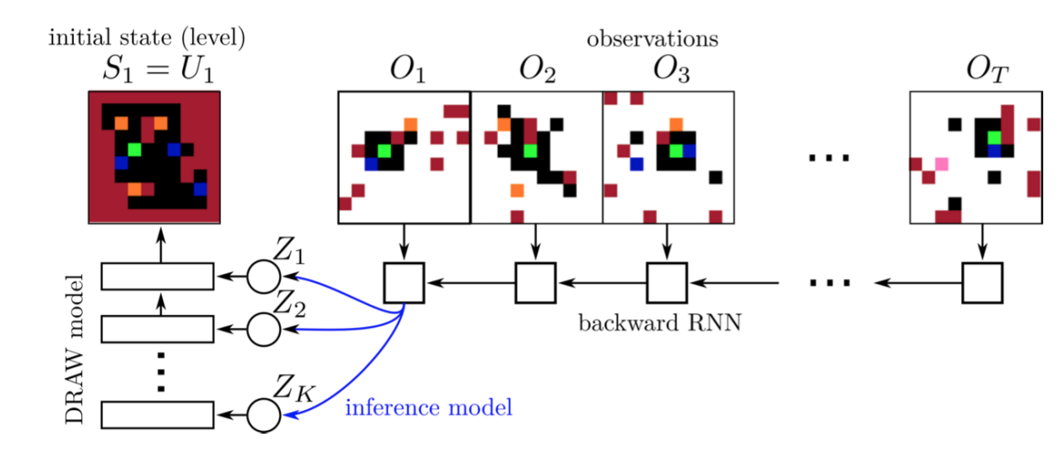
Counterfactual: policy search
Buesing et al. Woulda, Coulda, Shoulda: Counterfactually-Guided Policy Search, 2019
Notes:
可以反推各种U，一旦有了U之后，可以生成新的数据，这些数据都是在事实附近的微扰
Figure 3: Top: PO-SOKOBAN. Shown on the left is a procedurally generated initial state. The agent is shown in green, boxes in yellow, targets in blue and walls in red. The agent does not observe this state but a sequence of observations, which are masked by iid noise with 0.9 probability, except a 3x3 window around the agent. Bottom: Inference model. For counterfactual inference in PO-SOKOBAN, we need the (approximate) inference distribution p(Us1|hˆ T ) over the initial state Us1 = S1, conditioned on the history of observations hˆ T . We model this distribution using a DRAW generative model with latent variables Z, which are conditioned on the output of a backward RNN summarizing the observation history.

Slide 61
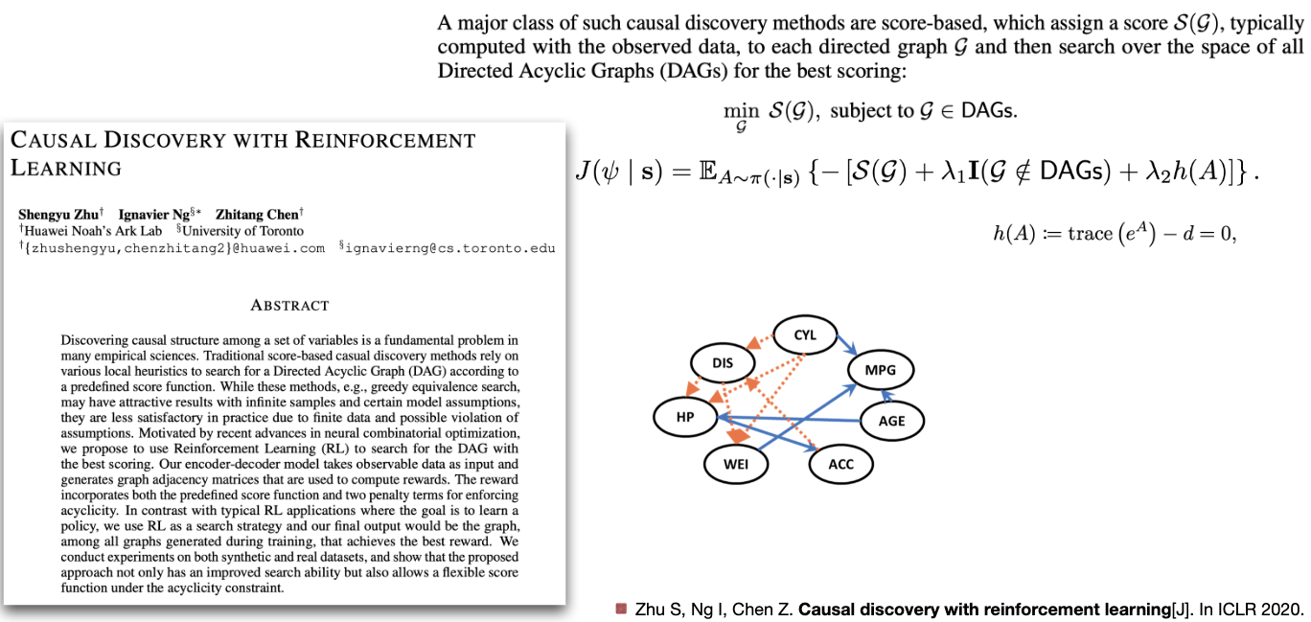
Causal Discovery
Zhu S, Ng I, Chen Z. Causal discovery with reinforcement learning, ICLR 2020

Slide 62
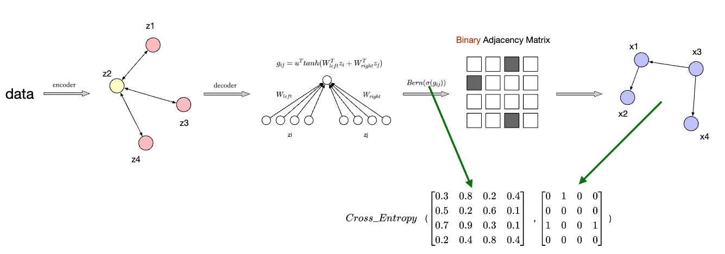
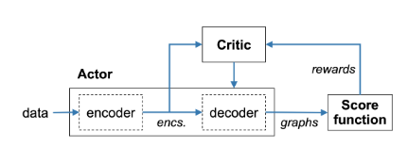
Causal Discovery
1. the predefined score function； 2. two penalty terms to enforce acyclicity
Zhu S, Ng I, Chen Z. Causal discovery with reinforcement learning, ICLR 2020

Slide 63

Problems Overview
Kaddour et al. 2022: https://arxiv.org/abs/2206.15475

Slide 64
Outline
Basic Notions
AlphaGo
Deep Q-Learning
Causal Reinforcement Learning
World Models
更多“人工智能 & 复杂系统”的知识，请关注官网：campus.swarma.org

Slide 65


Learning Causal Representations
Given possibly high-dim $X=(X_{1},X_{2},…,X_{d})$, we should construct causal variables $S=\left(S_{1},S_{2},…,S_{n}\right),$ where $n≪d$ as well as causal mechanisms :
$S_{i}=f_{i}(PA_{i},U_{i})$(i = 1,…, n) .
Causal Feature Learning: an injective mapping $q: ℝ^{n}→ℝ^{d} s.t. X=q(S)$
Causal Graph Discovery: a causal graph 𝒢_{S} among the causal variables S
Causal Mechanism Learning: the causal mechanisms $f_{i}$ or $p(S_{i}|PA_{i})$
https://arxiv.org/pdf/2102.11107.pdf

Slide 66
Hierarchy of Causality
Judea Pearl: The Book of Why

Slide 67


World Models
https://arxiv.org/pdf/1803.10122.pdf

Slide 68


World Models
https://arxiv.org/pdf/1803.10122.pdf

Slide 69


Dreaming
https://arxiv.org/pdf/1803.10122.pdf

Slide 70


Dreamers
https://arxiv.org/abs/1912.01603
https://arxiv.org/abs/2301.04104

Slide 71
Dreamers
Problems：
World without self
Dreaming is not autonomous
https://arxiv.org/abs/2301.04104

Slide 72


Self awareness
Dynamic Attention
https://arxiv.org/pdf/2204.07184.pdf

Slide 73


From System 1 to System 2
卡尼曼：思考，快与慢，中信出版社

Slide 74


Consciousness Machine？
https://arxiv.org/pdf/cs/0309048.pdf

Slide 75
Outline
AI history and Introduction
Automated Differential & PyTorch
Machine Learning Basics
Neural Networks I
Neural Networks II
Neural Ordinary Differential Equations
Representation Learning and Transfer Learning
Generative Models I
Generative Models II
Transformers and ChatGPT
Graph Neural Networks
Automated Modelling of Complex Systems
Causal Inference
Causal Machine Learning
Reinforcement Learning
更多“人工智能 & 复杂系统”的知识，请关注官网：campus.swarma.org

